Slide 1

Operating Systems
Jinghui Zhong （钟竞辉）
Office：B3-515
Email ：jinghuizhong@scut.edu.cn

Slide 2

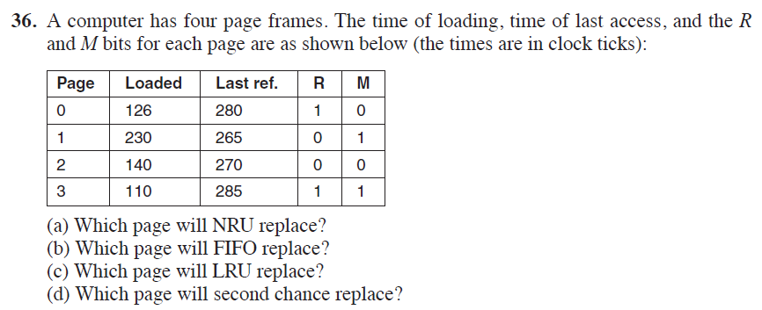
主观题
10分
请您编辑题干
作答

Slide 3
Chapter 3
Answer:
Page 2, because both R and M bit are 0
Page 3, because it loaded at 110 time, which is the earliest.
Page 1, because its last reference at 265, which is the earliest.
Page 2

Slide 4
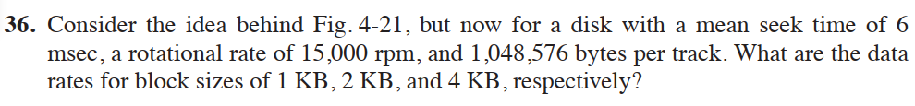
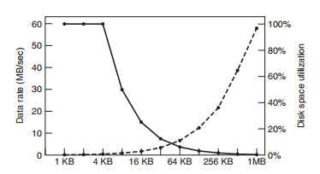
主观题
10分
请您编辑题干
作答

Slide 5
Chapter 4
Answer:
At 15,000 rpm, the disk takes 4 msec to go around once. The average access time (in msec) to read k bytes is then 6 + 2 + (k/1, 048, 576) ⋅ 4.
For blocks of 1 KB, 2 KB, and 4 KB, the access times are about 8.0039 msec, 8.0078 msec, and 8.0156 msec, respectively.
These give rates of about 124.939 KB/sec, 255.751 KB/sec, and 511.004 KB/sec, respectively

Slide 6
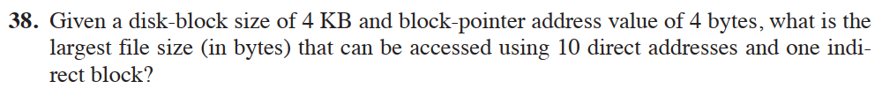
主观题
10分
请您编辑题干
作答

Slide 7
Chapter 4
The indirect block can hold 1024 addresses. Added to the 10 direct addresses, there are 1034 addresses in all. Since each one points to a 4-KB disk block, the largest file is 4136KB.

Slide 8
主观题
10分
请您编辑题干
作答

Slide 9
Chapter 5
It rotates 7200/60 = 120 times per second. So it require 1/120*1000=8.33ms for one rotation. So reading a sector needs 8.33/500 = 0.0167ms.

Slide 10
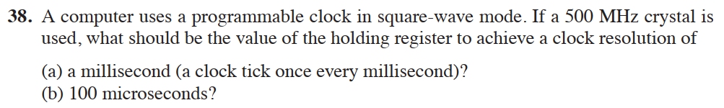
主观题
10分
请您编辑题干
作答

Slide 11
Chapter 5
Answer:
(1) 500MHz/1ms = 500,000. So the register needs holding 500,000.
500MHz/100us = 50,000. The register needs holding 50,000.

Slide 12
投票
最多可选1项
Should daemons have higher or lower priority than interactive processes？
A
The daemons should have a higher priority
B
Interactive processes should have a higher priority
提交

Slide 13
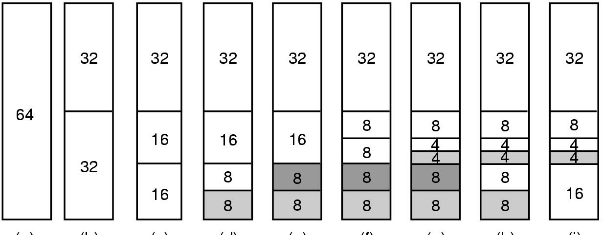
Memory Allocation Mechanism
The main mechanism for allocating new page frames of physical memory is the page allocator. The page allocator operates using the well-known buddy algorithm.
Buddy Algorithm

Slide 14
主观题
1分
Memory Size： 1024 K;
Events：
1: A 70K;
2: B 35K;
3: C 80K;
4: A ends;
5: D 60K;
6: B ends;
7: D ends;
8: C ends;
The buddy algorithm is used to allocate memory.
Please draw the change of memory.
正常使用主观题需2.0以上版本雨课堂
作答

Slide 15
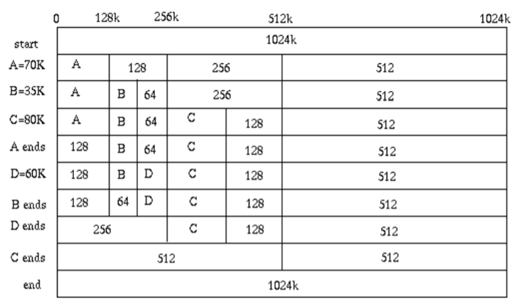
Buddy Algorithm: An Example
Memory size： 1024 K;
Events:
1: A 70K;
2: B 35K;
3: C 80K;
4: A ends;
5: D 60K;
6: B ends;
7: D ends;
8: C ends;
9:
15

Slide 16
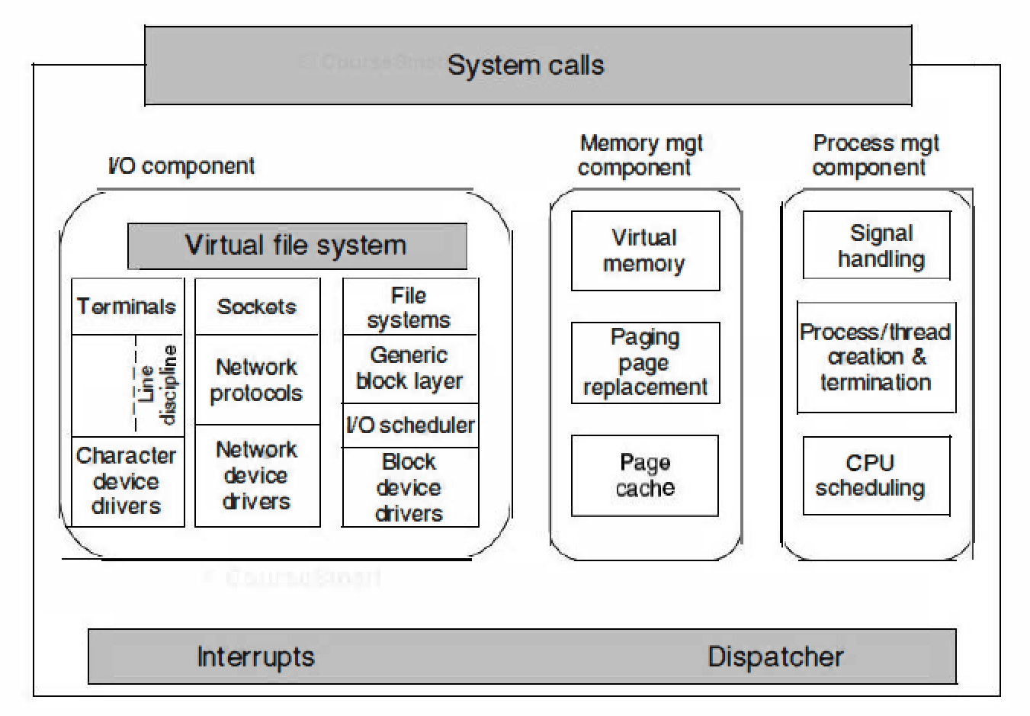
Linux Kernel
The kernel sits directly on the hardware and consists of : I/O Device Component; Memory Management Component, and Processes Management Component
Structure of the Linux kernel

Slide 17
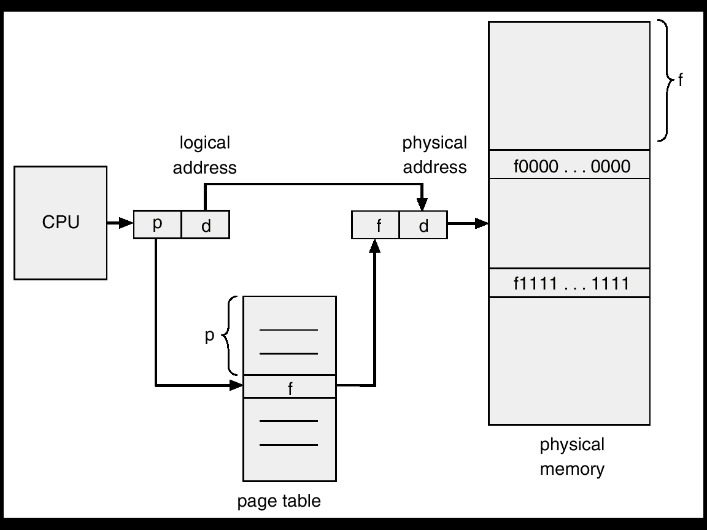
Memory Management in Linux
Virtual Memory (VM):
Allow multiple processes share the physical memory;
Allow the execution of big process.
Techniques to improve VM’s efficiency:
TLB, multi-level page table

Slide 18
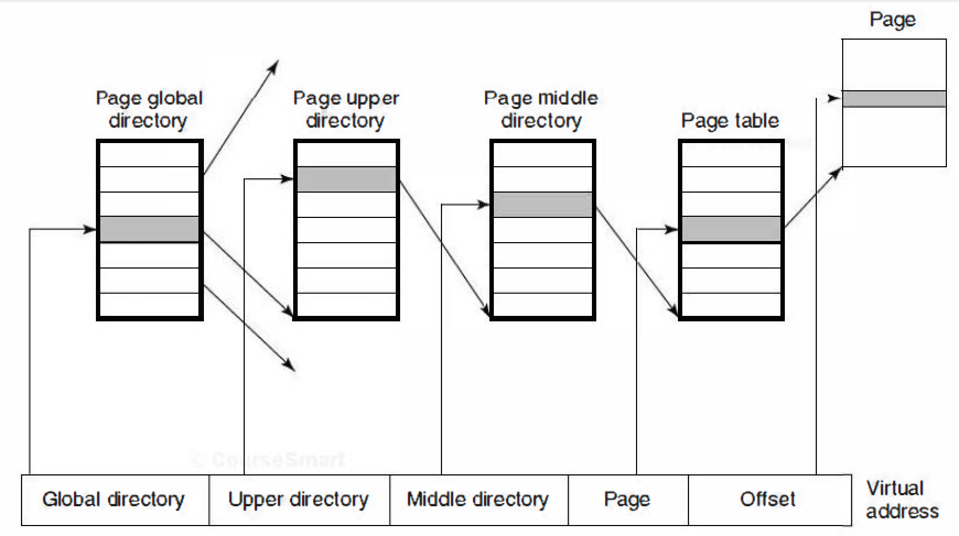
Multiple Level Page Table
Each virtual address is broken up into five fields. The value of each directory entry is a pointer to one of the next-level directories.
Linux uses four-level page tables

Slide 19
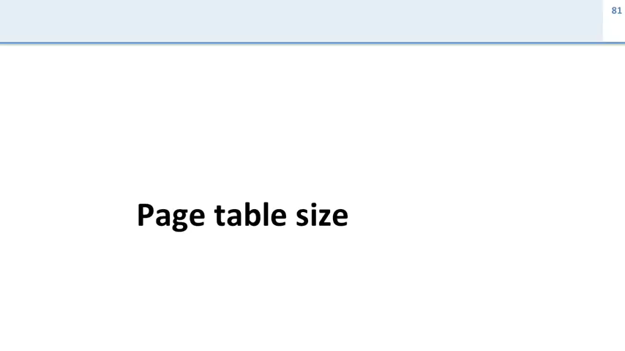

Slide 20
Page Replacement Mechanism
A page daemon is initialized at the beginning;
The page daemon checks the page usage periodically (100ms) ; it will free up more pages if the number of free pages is not enough；
Four types of pages：
unreclaimable：e.g., locked pages, kernel mode stack;
swappable：must be written back before being reclaimed；
syncable：must be written back if it is dirty；
discardable：can be reclaimed immediately.

Slide 21
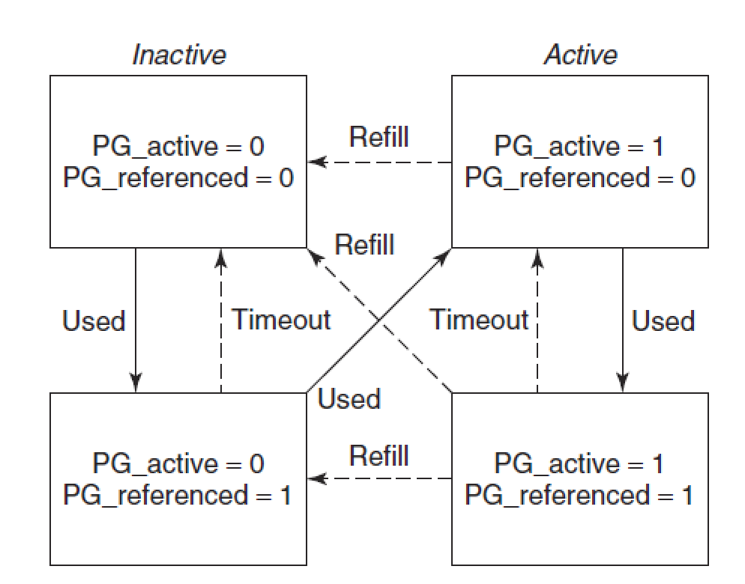
Page Replacement Algorithm
Uses an enhanced LRU algorithm, maintaining two flags per page: active/inactive, and referenced or not.
In the first scan, the reference bits of pages are cleared. If during the second scan, the page is referenced it is moved to a state that is less likely to be reclaimed. Otherwise, the page is moved to a state that is more likely to be reclaimed.

Slide 22
单选题
1分
When Linux implements virtual address translation, it adopts () level page table.
A
1
B
2
C
3
D
4
提交

Slide 23
Linux I/O
Linux integrates devices into the file system as what are called special files.
Block special files—magnetic disks, etc.
Character special files—keyboards, printers, mice, etc.
IDE hard disk
SATA hard disk
USB flash disk
printer
mouse
CD-ROM

Slide 24
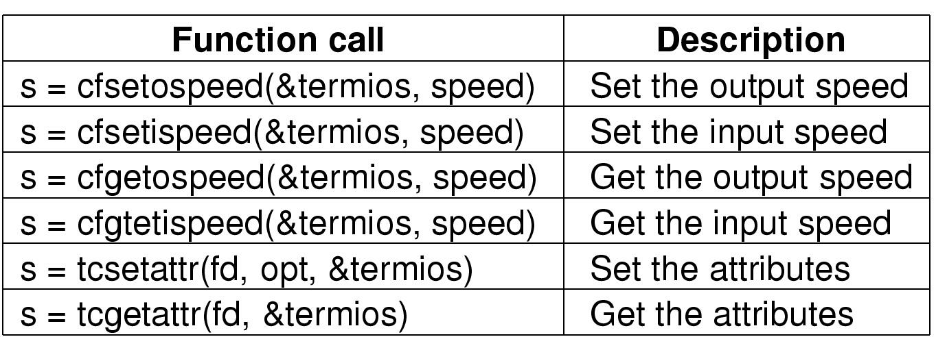
Input/Output System Calls in Linux
Each I/O device in a Linux system generally has a special file associated with it. Most I/O can be done by just using the proper file.
Some special files require special POSIX calls.
The main POSIX calls for managing the terminal

Slide 25
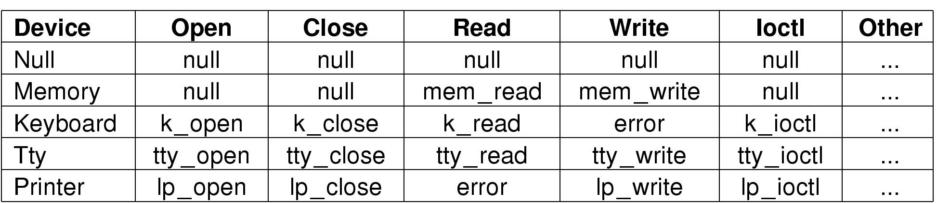
Implementation of Input/Output in Linux
Each special file is associated with a device driver that handles the corresponding device.
Major device number——to identify the types of devices
Minor device number——to identify devices of the same type
The system indexes into the hash table of character devices to select the proper structure, then calls the corresponding function to have the work performed.
Some of the file operations supported for typical character devices

Slide 26
The Linux File System
Files can be grouped together in directories; Directories are stored as files; Directories can contain subdirectories.
The root directory is called / （slash), and the / character is also used to separate directory names.
Directory | Contents
bin | Binary (executable) programs
dev | Special files for I/O devices
etc | Miscellaneous system files
lib | Libraries
usr | User directories
Some important directories found in most Linux systems

Slide 27
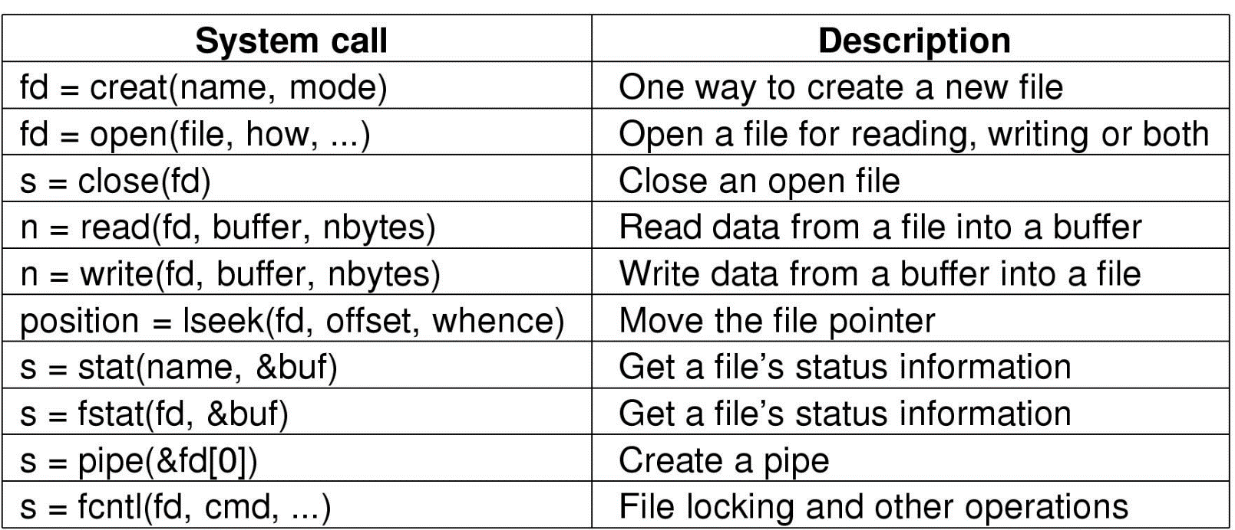
Some system calls for files
The return code s is -1 if an error has occurred; fd is a file descriptor, and position is a file offset. The parameters should be self explanatory

Slide 28
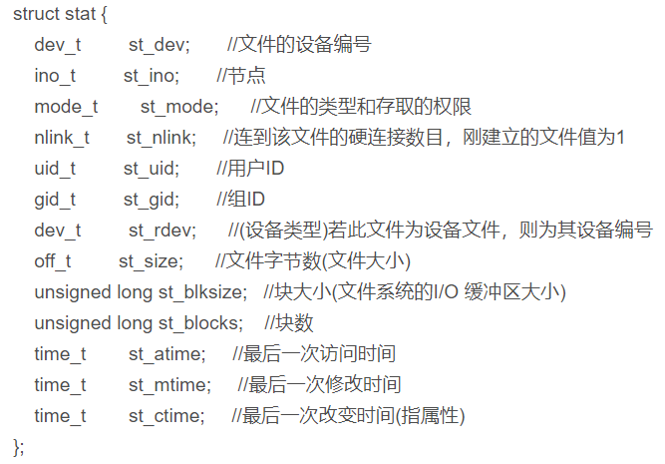
Stat System Call
For each file, Linux records its file type, size, last modification time, etc., which can be viewed by using stat system call
#include <sys/stat.h> #include <unistd.h> #include <stdio.h> int main() { struct stat buf; stat("/etc/hosts", &buf); printf("/etc/hosts file size = %d\n", buf.st_size);
return 1； }

Slide 29
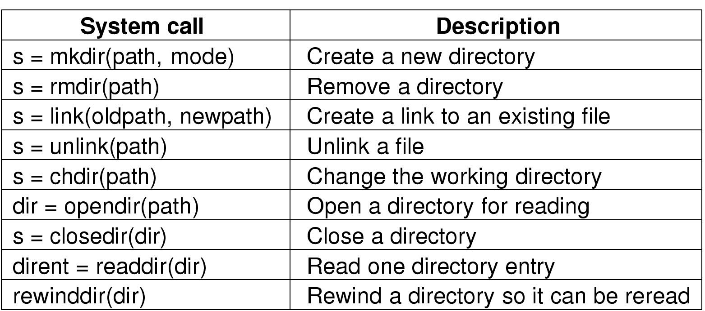
Some System Calls for Directories
mkdir, rmkdir：to create and to destroy directories (A directory can only be removed if it is empty)
link：to create a link；unlink：to delete a link
chdir：to change the working directory
opendir，closedir，readdir，rewinddir：for reading directories

Slide 30
#include <sys/types.h>
#include <dirent.h>
#include <unistd.h>
Int main()
{ DIR * dir;
struct dirent * ptr;
int i;
dir = opendir("/etc/rc.d");
while((ptr = readdir(dir)) != NULL) {
printf("d_name : %s\n", ptr->d_name);
}
closedir(dir);
return 1；
}

Slide 31
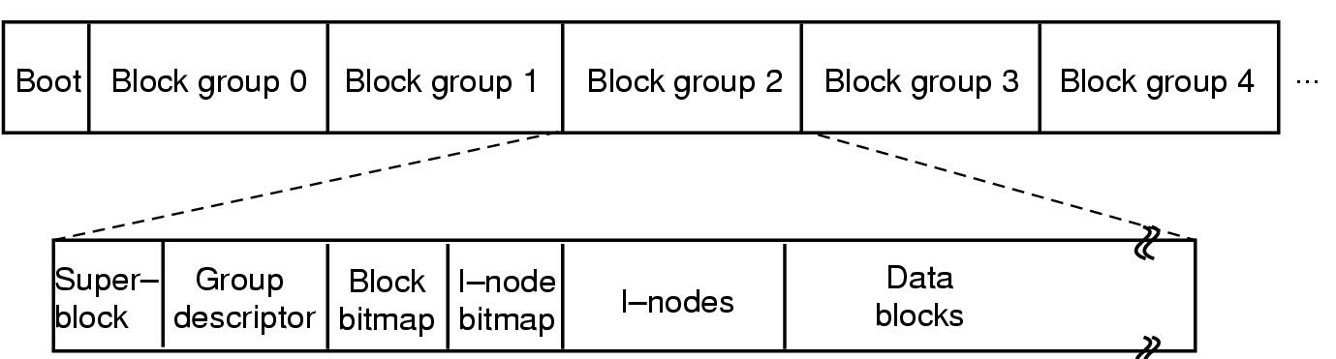
The Linux Ext2 File System
block 0：contains code to boot the computer
superblock：contains information about the layout of the file system(number of i-nodes, number of disk blocks, etc.)
group descriptor：contains information about the location of the bitmaps, the number of free blocks and i-nodes in the group, etc.
two bitmaps：keep track of the free blocks and free i-nodes, respectively
i-nodes: contains accounting information as well as enough information to locate all the disk blocks that hold the file’s data
data blocks: areas where all files and directories store
Disk layout of the Linux ext2 file system

Slide 32
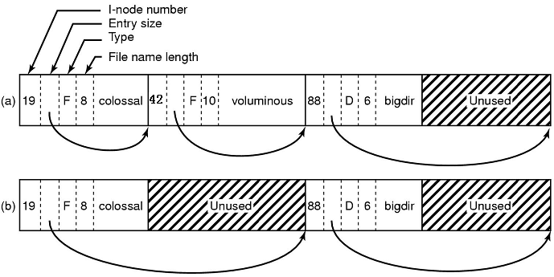
The Linux Ext2 File System
The directory file allows file names up to 255 characters.
Each directory consists of some integral number of disk blocks so that directories can be written atomically to the disk.
Entries for files and directories are in unsorted order within a directory.
Entries may not span disk blocks.
(a). A Linux directory with three files
(b). The same directory after the file voluminous has been removed

Slide 33
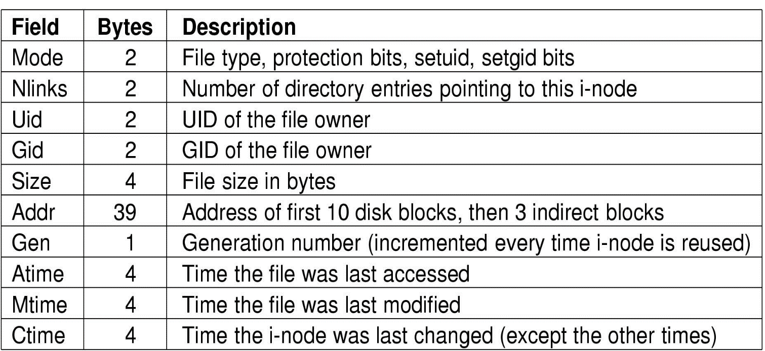
The Structure of I-Node
The i-node is put in the i-node table, a kernel data structure that holds all the i-nodes for currently open files and directories.
Some fields in the i-node structure in Linux

Slide 34
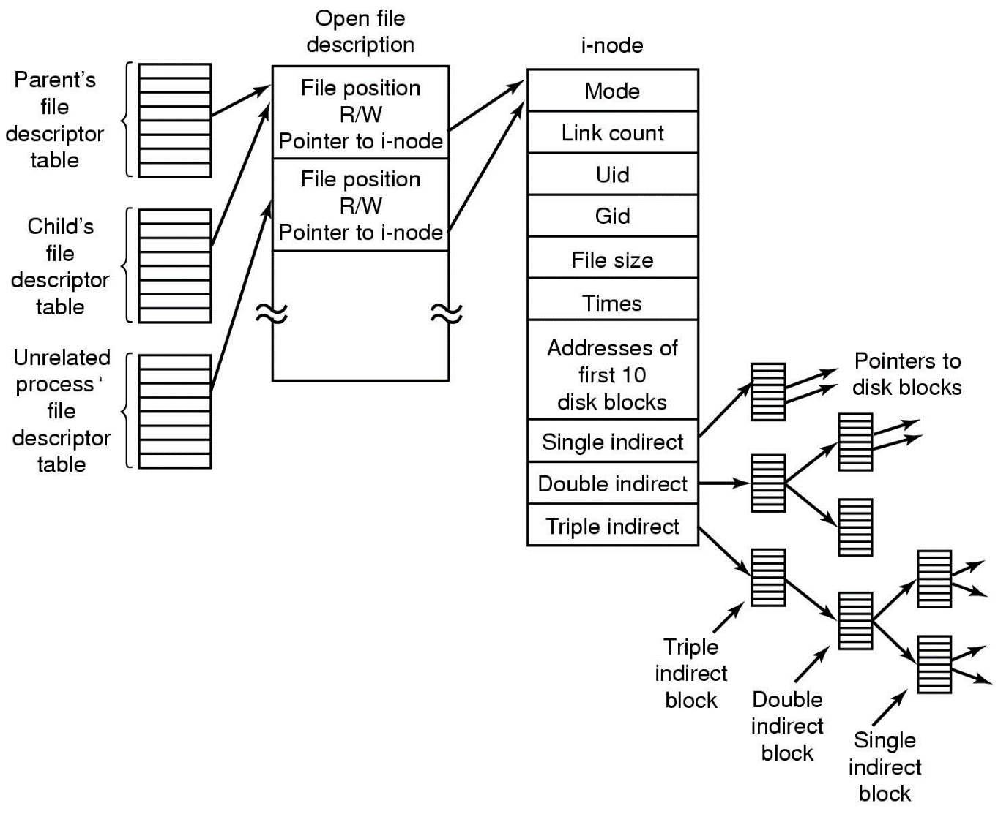
Linux ext2 File System
If a block sizes 1KB with an address of length 4 byte, based on the I-node structure, what is the maximum size of a file? ？
Ans：
16843020KB
≈ 16448.3MB
≈ 16.1GB
The relation between the file descriptor table,
the open file description table, and the i-node table

Slide 35
单选题
1分
According to the content of the file, Linux divides the file into ( ) three categories
A
System file, User file and Device file
B
General file, Stream file and Record file
C
Directory file, Streaming file, Device file
D
Common file, Directory, Special file
提交

Slide 36
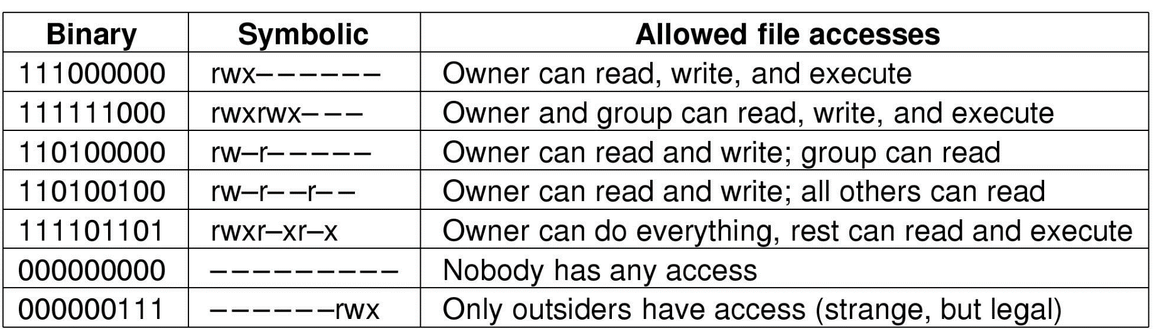
Security in Linux
The user community for a Linux system consists of some number of registered users, each of whom has a unique UID(User ID) which is an integer between 0 and 65535.
Users can be organized into groups, which are also numbered with 16-bit integers called GIDs(Group IDs).
The basic security mechanism in Linux is simple. Each process carries the UID and GID of its owner.
read
write
execute
Please try the others
Some example file protection modes
others
group
Owner

Slide 37
Security System Calls in Linux
chmod：the most heavily used one, to change the protection mode
access：to see if a particular access would be allowed using the real UID and GID
getuid,geteuid,getgid,getegid：return the real and effective UIDs and GIDs
chown,setuid,setgid：only allowed for the superuser, to change a file’s owner, and to change the process’ UID and GID
System call | Description
s=chmod(path,mode) | Change a file’s protection mode
s=access(path,mode) | Check access using the real UID and GID
uid=getuid() | Get the real UID
uid=geteuid() | Get the effective UID
gid=getgid() | Get the real GID
gid=getegid() | Get the effective GID
s=chown(path,owner,group) | Change owner and group
s=setuid(uid) | Set the UID
s=setgid(gid) | Set the GID

Slide 38
主观题
1分
Suppose the size of the page is 4KB, and 4B is used for a page table entry. If a page table is required to manage the virtual address space with address structure of 36 bits, and each page table only occupies one page. How many levels are needed to meet the management requirements when using multi-level page table structure?
正常使用主观题需2.0以上版本雨课堂
作答

Slide 39
Suppose the size of the page is 4KB, and 4B is used for a page table entry. If a page table is required to manage the virtual address space with address structure of 36 bits, and each page table only occupies one page. How many levels are needed to meet the management requirements when using multi-level page table structure?
Answer：
Offset = 2^12, need 12 bits;
One page can store 4KB/4B = 2^10 enties;
So the number of levels > (36 – 12)/10 = 2.4
→ the number of levels = 3;

Slide 40
Problem Types
Type1：Choice questions (5 problems, each 2 points)
Type2：Explain the meaning of items (5 problems, each 4 points),
e.g., Thread, Page Table
Type3：Questions, Calculation Problems, & IPC problem,
e.g., Each process has three states. Draw a diagram to show the transitions between these three states. If there are multiple processes in the ready state, the scheduler will use a scheduling strategy to select one process to run the CPU. Describe the basic ideas of the following process scheduling strategies: Round robin, Priority scheduling, and shortest job first. (15 points)

Slide 41
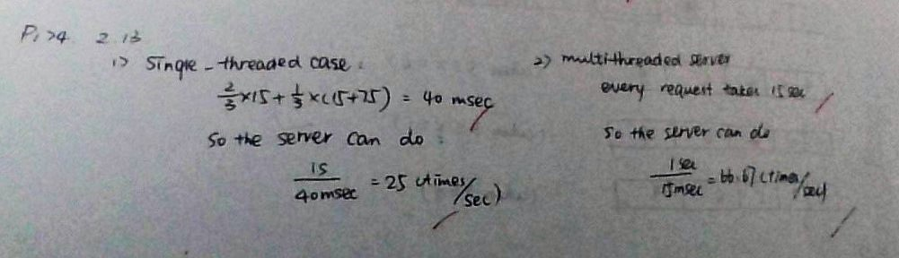

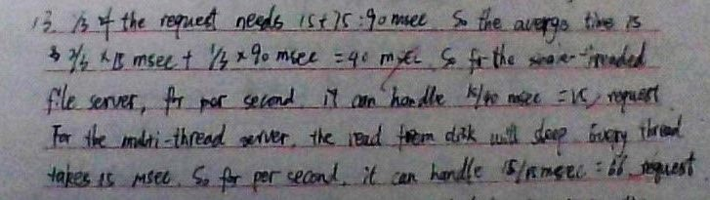

Answer Skills
Organize your answers and make the important points clear.

Slide 42
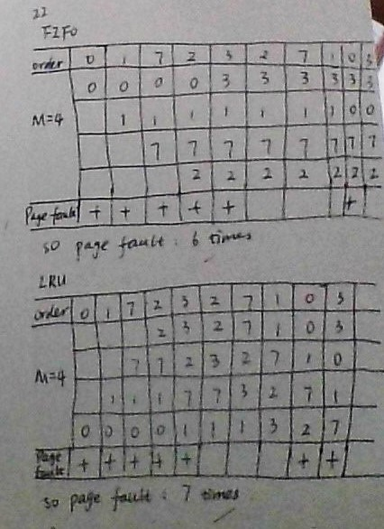
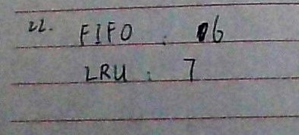
Answer Skills
Explain your answers.

Slide 43
Session 1
【Objective and Requirement】
Objective： Be familiar with the creation of process and thread.
Requirement：
Task 1: Create a console application, “child”, which keeps printing out “The child is talking at [system time]” (in a loop, one per 1s).
Task 2: Create another console application, “parent”. It create a child process to execute “child”. At the same time, the “parent” process keeps printing out “The parent is talking at [system time]”. (one per 1s). Execute “parent” and explain the output you see.
Task 3: Create a child thread in the “mainThread” program. Both the main thread and the child thread keep printing out “[ThreadID] + [System time]”.
Task 4: Create a console application, which contains a shared integer shared_var. The initial value of shared_var is 0. The application will create a child thread after it starts. The main thread keeps increasing the value of shared_var by 1, while the child thread keeps decreasing the value of shared_var by 1. Explain the observed results.
【Environment】
Operating System：Linux;

Slide 44
Brief Review

Slide 45
What is Operating System (OS)
A computer = Hardware + OS + User Programs
The distinct features of OS
User mode
User programs
Software
Kernel mode
Operating System
Hardware
Run in kernel mode;
Has complete access to all hardware;
Can execute any instruction the machine is capable of executing;
Huge, complex, long-lived;
Two major tasks of OS.
To provide abstractions and to manage resources

Slide 46
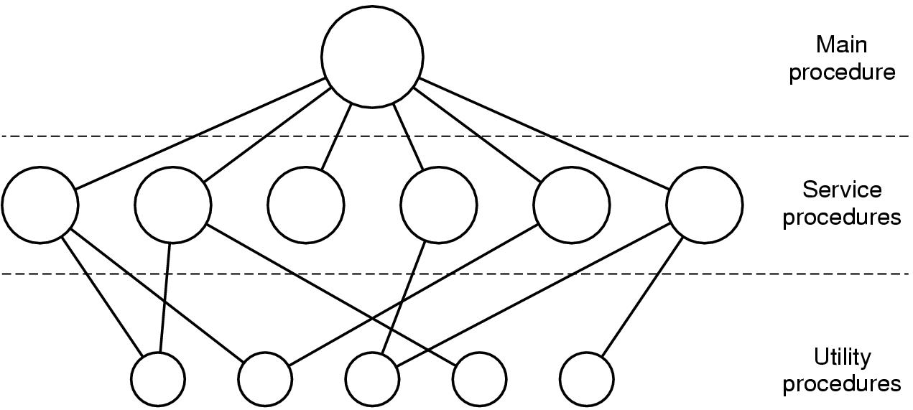
Monolithic System
All operating system operations are put into a single file. The operating system is a collection of procedures, each of which can call any of the others. (e.g., Linux, windows)
46

Slide 47
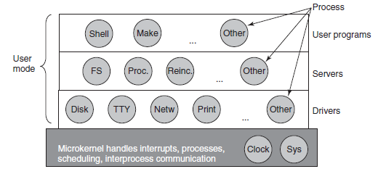
Microkernels
Split the OS into modules, only one runs in kernel mode and the rest run in user mode; (a lot communication)
Put as little as possible into kernel model to improve the reliability of the system.
Examples: MINIX 3
47

Slide 48
Processes
What is a process?
a program in execution.
a container that holds all the information needed to run a program.

Slide 49
Process Creation
Events that cause process creation
System initialization
Created by a running process.
User request to create a new process
Initiation of a batch job
Foreground processes: processes that interact with users and perform work for them.
Background processes that handle some incoming request are called daemons.
49

Slide 50
Process Termination
Conditions that cause process termination
Normal exit (voluntary)
“Exit” in UNIX and “ExitProcess” in Windows.
Error exit (voluntary)
Example: input file is not exist.
Fatal error (involuntary)
Example: referencing nonexistent memory.
Killed by another process (involuntary)
“Kill” in UNIX and “TerminateProcess” in Windows.
50

Slide 51
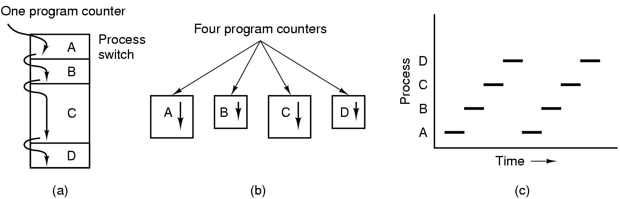
Multiprogramming
The CPU switches from process to process quickly, running each for tens or hundreds of milliseconds.
At anytime, the CPU is running only one process.
51

Slide 52
Process States
A single process in running state
Running
…
…
Blocked
Ready
Multiple processes
Multiple processes
Running：using the CPU at that instant.
Ready：runnable; temporarily stopped to let another process run.
Blocked：unable to run until some external event happens.

Slide 53
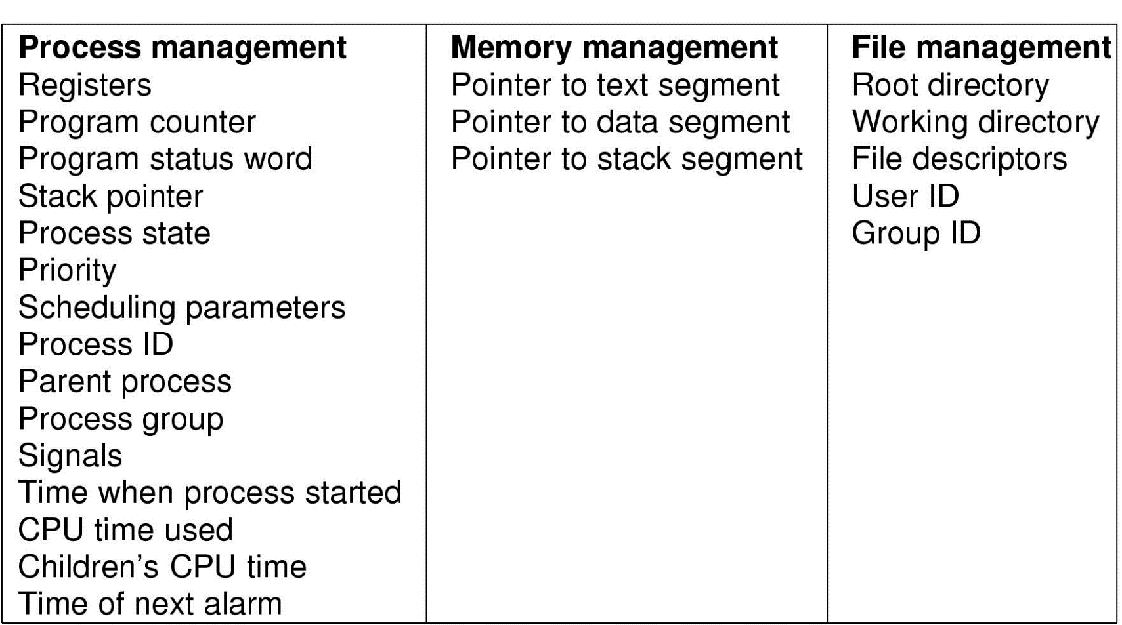
Implementation of Processes
The OS maintains a Process Table with one entry (called a process control block (PCB)) for each process.
53

Slide 54
Modeling Multiprogramming
Suppose a process spends a fraction p of its time waiting for I/O to complete. With n processes in memory at once. The CPU utilization can be obtained by:
CPU utilization = 1 – p^{n}
54

Slide 55
Thread
A thread – lightweight process, a basic unit of CPU utilization.
It comprises a thread ID, a program counter, a register set, and a stack.
A traditional (heavyweight) process has a single thread of control.
If the process has multiple threads of control, it can do more than one task at a time. This situation is called multithreading.
Process：used to group resources together;
Thread：the entity scheduled for execution on the CPU.
55

Slide 56
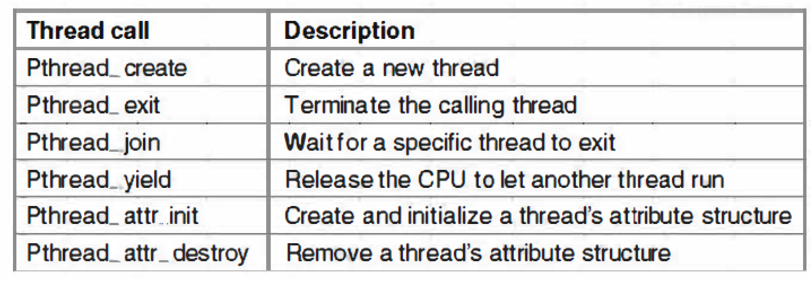
POSIX Threads
POSIX (Portable Operating System Interface) is a set of standard operating system interfaces based on the Unix operating system.
The need for standardization arose because enterprises using computers wanted to be able to develop programs that could be moved among different manufacturer's computer systems directly.
56

Slide 57
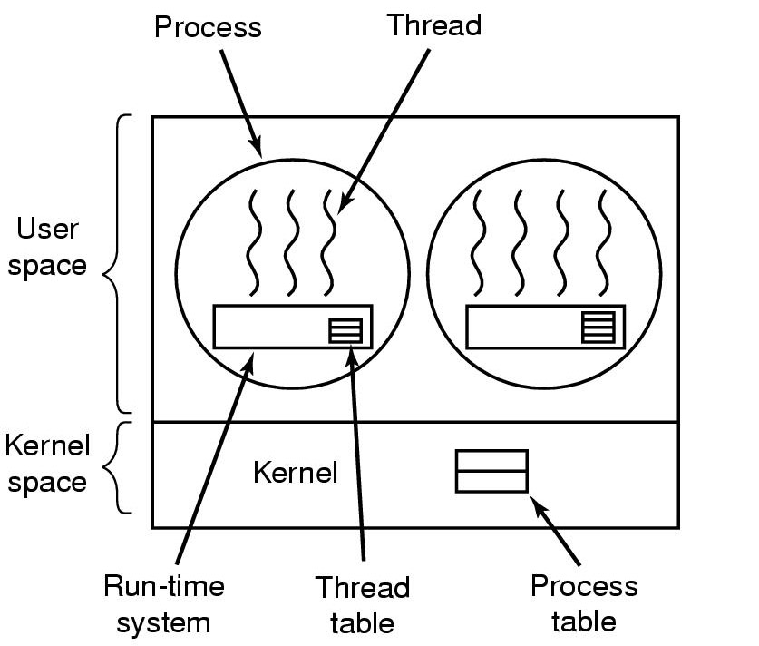
Implementing threads in user space
Advantages: fast, flexible, scalable
Drawbacks：
1) Blocking blocks all threads in a process;
2) No thread-level parallelism on multiprocessor.
57

Slide 58
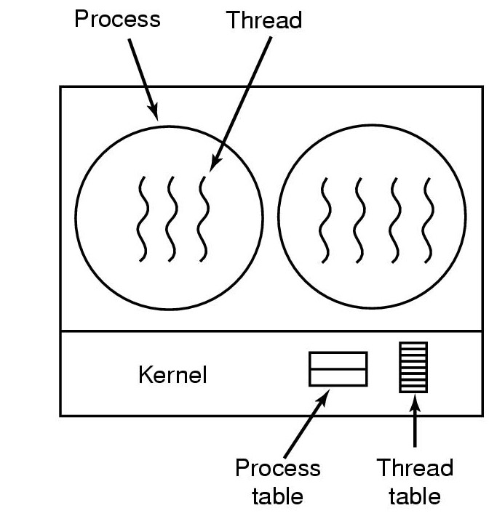
Implementing threads in kernel
Advantages: Blocking blocks only the appropriate thread in a process; Support thread-level parallelism on multiprocessor;
Disadvantages: Slow thread management; large thread tables
58

Slide 59
Race Conditions
Race conditions: situations in which several processes access shared data and the final result depends on the order of operations.
With increasing parallelism due to increasing number of cores, race condition are becoming more common.
59

Slide 60
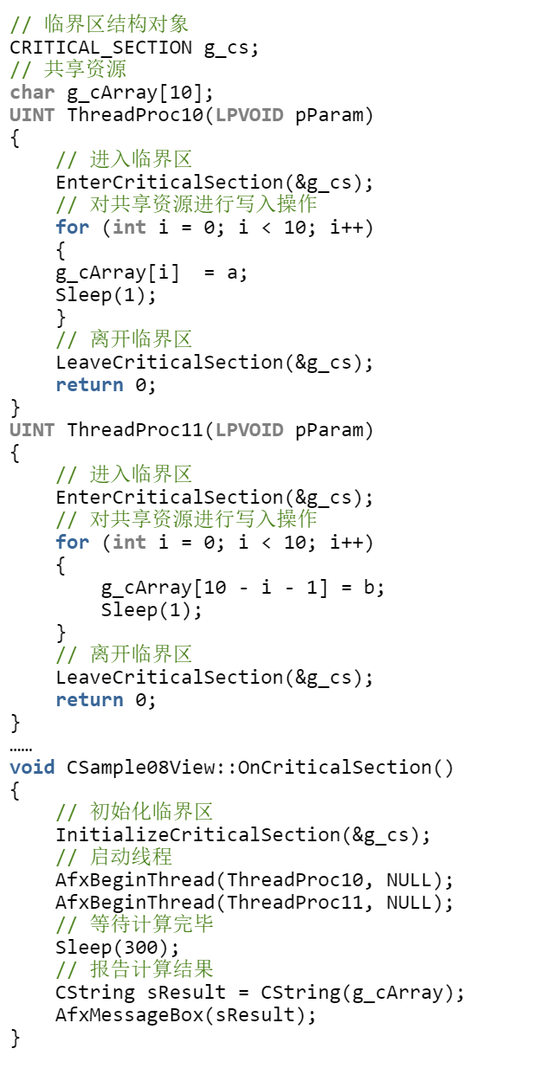
Critical Regions
Key idea to avoid race condition：prohibit more than one process from reading and writing the shared data at the same time.
Critical Region: part of the program where the share memory is accessed。
60

Slide 61
Semaphores [E.W. Dijkstra, 1965]
A SEMAPHORE, S, is a structure consisting of two parts:
(a) an integer counter, COUNT
(b) a queue of pids of blocked processes, Q
That is,
struct sem_struct {
int count;
queue Q;
} semaphore;
semaphore S;
61

Slide 62
Semaphores [E.W. Dijkstra, 1965]
There are two operations on semaphores, UP and DOWN (PV). These operations must be executed atomically (that is in mutual exclusion). Suppose that P is the process making the system call. The operations are defined as follows:
DOWN(S):
if (S.count > 0)
S.count = S.count - 1;
else
block(P); that is,
(a) enqueue the pid of P in S.Q,
(b) block process P (remove the pid from the ready queue)
(c) pass control to the scheduler.
62

Slide 63
Semaphores [E.W. Dijkstra, 1965]
UP(S):
if (S.Q is nonempty)
wakeup(P) for some process P in S.Q; that is,
(a) remove a pid from S.Q (the pid of P),
(b) put the pid in the ready queue, and
(c) pass control to the scheduler.
else
S.count = S.count + 1;
63

Slide 64
Mutual Exclusion Solution
Semaphores do not require busy-waiting, instead they involve BLOCKING.
semaphore mutex = 1; // set mutex.count = 1
DOWN(mutex);
- critical section -
UP(mutex);
64

Slide 65
Using Semaphores
Process Synchronization:
Suppose we have 4 processes: A, B, C, and D. A must finish executing before B start. B and C must finish executing before D starts.
How many semaphores should be used to achieve the above goal?
B
A
D
C
65

Slide 66
Using Semaphores
Process Synchronization:
Process A:
- do work of A
UP(S1); /* Let B or C start */
Process B:
DOWN(S1); /* Block until A is finished */
- do work of B
UP(S2);
Process C: - do work of C
UP(S3);
Process D:
DOWN(S2);
DOWN(S3);
- do work of D
B
A
D
C
66

Slide 67
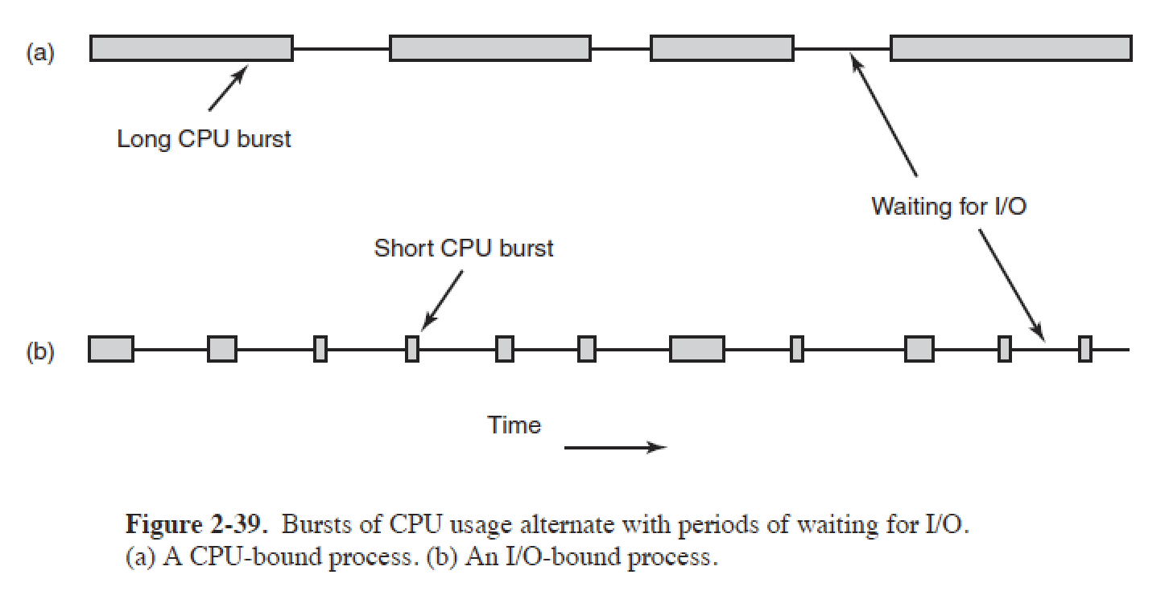
Process Behavior
Nearly all processes alternate bursts of computing with I/O requests.
CPU-bound: Spend most of the time computing.
IO-bound: Spend most of the time waiting for I/O.
67

Slide 68
Process Scheduling
Scheduler: A part of the operating system that decides which process is to be run next.
Scheduling Algorithm: a policy used by the scheduler to make that decision.
To make sure that no process runs too long, a clock is used to cause a periodic interrupt (usually around 50-60 Hz); that is, about every 20 msec.
Preemptive Scheduling: allows processes that are runnable to be temporarily suspended so that other processes can have a chance to use the CPU.
68

Slide 69
Scheduling Algorithm Goals
Fairness - each process gets its fair share of time with the CPU.
Efficiency - keep the CPU busy doing productive work.
Response Time - minimize the response time for interactive users.
Turnaround Time - minimize the average time from a batch job being submitted until it is completed.
Throughput - maximize the number of jobs processed per hour.
69

Slide 70
First-Come, First-Served (FCFS) Scheduling
Process Burst Time
P₁ 24
P₂ 3
P₃ 3
Suppose that the processes arrive in the order: P₁ , P₂ , P₃
Waiting time for P₁, P₂, and P₃ = 0，24，27
Average waiting time = (0+24+27)/3 = 17
70

Slide 71
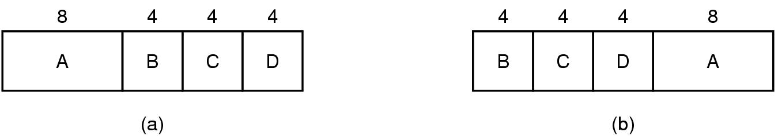
Shortest-Job-First (SJF) Scheduling
Associate with each process the length of its next CPU burst. Use these lengths to schedule the process with the shortest time.
An example of shortest job first scheduling
Drawback?
The real difficulty with the SJF algorithm is knowing the length of the next CPU request.
71

Slide 72
Shortest-Job-First (SJR) Scheduling
Two schemes:
nonpreemptive – once CPU given to the process it cannot be preempted until it completes its CPU burst.
preemptive – if a new process arrives with CPU burst length less than remaining time of current executing process, preempt. This scheme is know as the Shortest-Remaining-Time-First (SRTF).
SJF is optimal – gives minimum average waiting time for a given set of processes.
72

Slide 73
Example of Non-Preemptive SJF
Process Arrival Time Burst Time
P₁ 0.0 7
P₂ 2.0 4
P₃ 4.0 1
P₄ 5.0 4
SJF (non-preemptive)
Average waiting time = ?
73

Slide 74
Example of Non-Preemptive SJF
Process Arrival Time Burst Time
P₁ 0.0 7
P₂ 2.0 4
P₃ 4.0 1
P₄ 5.0 4
SJF (non-preemptive)
Average waiting time = (0 + 6 + 3 + 7)/4 = 4
P₁
P₃
P₂
P₄
0
3
7
8
12
16
74

Slide 75
Round Robin (RR) Scheduling
Each process gets a small unit of CPU time (time quantum), usually 10-100 milliseconds. After this time has elapsed, the process is preempted and added to the end of the ready queue.
If there are n processes in the ready queue and the time quantum is q, then each process gets 1/n of the CPU time in chunks of at most q time units at once. No process waits more than (n-1)q time units.
Performance
q large ⇒ FIFO
q small ⇒ q must be large with respect to context switch, otherwise overhead is too high.
75

Slide 76
Example of RR with Time Quantum = 20
Process Burst Time
P₁ 53
P₂ 17
P₃ 68
P₄ 24
The Gantt chart is:
Typically, higher average turnaround than SJF, but better response.
P₁
P₂
P₃
P₄
P₁
P₃
P₄
P₁
P₃
P₃
0
20
37
57
77
97
117
121
134
154
162
76

Slide 77
Priority Scheduling
A priority number (integer) is associated with each process
The CPU is allocated to the process with the highest priority (smallest integer ≡ highest priority).
Preemptive
nonpreemptive
SJF is a priority scheduling where priority is the predicted next CPU burst time.
Problem: Starvation – low priority processes may never execute.
Solution: Aging – as time progresses increase the priority of the process.
77

Slide 78
Computer Deadlock:
What it is and how to model it

Slide 79


What is deadlock?
Definition
A set of processes(e.g., ) is in a deadlock state when every process in the set is waiting for a resource that can only be released by another process in the set.
Not enough resource
Deadlock
79

Slide 80
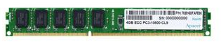
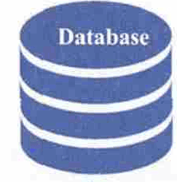

Resources
A resource is anything that can be acquired, used, and released over the course of time.
Resource
……
80

Slide 81
Two types of Resources
Preemptable resources
can be taken away from a process with no ill effects (e.g. memory)
Nonpreemptable resources
will cause the process to fail if taken away (e.g. CD recorder)
Potential deadlocks that involve Preemptable resources can usually be resolved by reallocating resources from one process to another.
81

Slide 82
Conditions for Deadlocks
Mutual exclusion
Resources are held by processes in a non-sharable (exclusive) mode.
Hold and Wait
A process holds a resource while waiting for another resource.
No Preemption
There is only voluntary release of a resource - nobody else can make a process give up a resource.
Circular Wait
Process A waits for Process B waits for Process C .... waits for Process A.
ALL of these four conditions must happen simultaneously for a deadlock to occur.
82

Slide 83

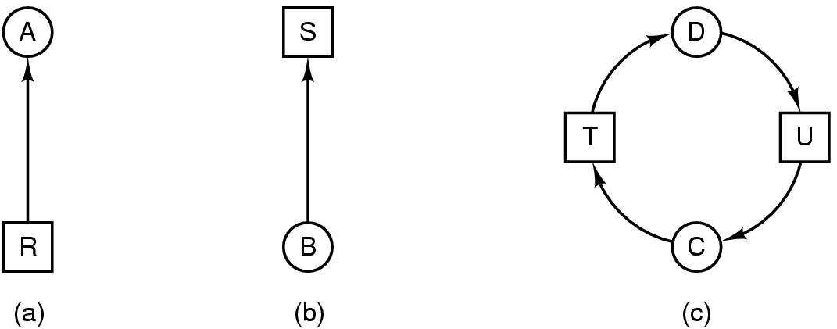
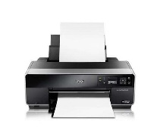
Deadlock Modeling (Resource with single instance)
Modeled with directed graphs
(a) resource R assigned to process A
(b) process B is requesting/waiting for resource S
Process
Resource
83

Slide 84

Deadlock Modeling (Resource with single instance)
Modeled with directed graphs
Process C and D are in deadlock over resources T and U
Process
Resource
84

Slide 85
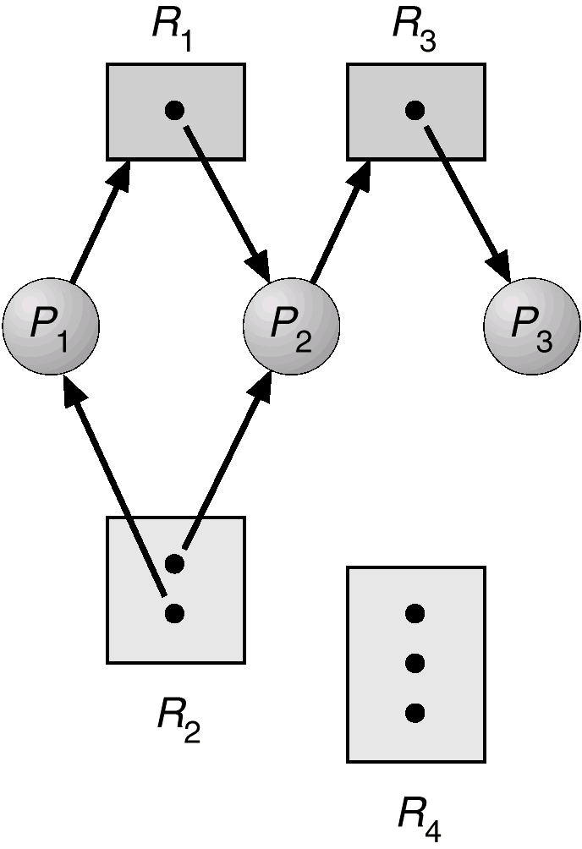
Example (1)
85

Slide 86
Basic Fact
86
If graph contains no cycles ⇒ no deadlock.
If graph contains a cycle ⇒
if only one instance per resource type, then deadlock.
if several instances per resource type, possibility of deadlock.

Slide 87

The Ostrich Algorithm
Pretend that there is no problem
Reasonable if
deadlocks occur very rarely
cost of prevention is high
Deadlock
87

Slide 88
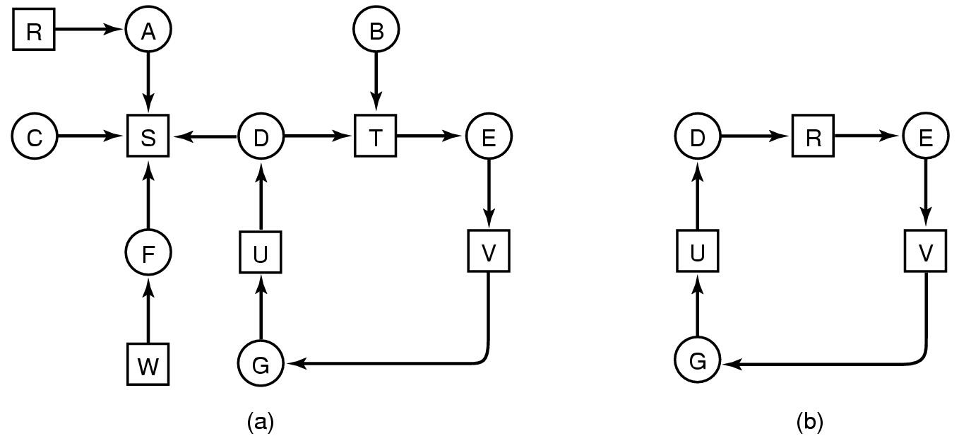
Detection with One Resource of Each Type
Note the resource ownership and requests
A cycle can be found within the graph, denoting deadlock
Many algorithms for detecting cycles in directed graphs.
88

Slide 89
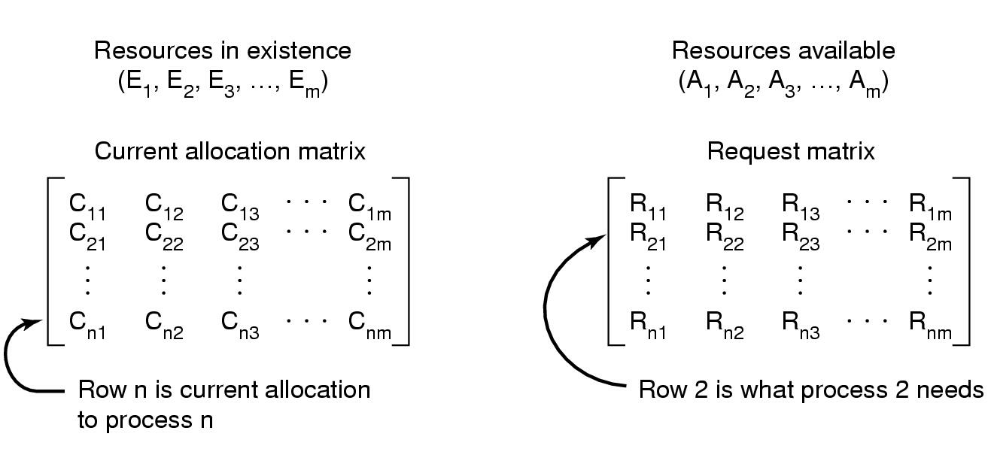
Detection with Multiple Resources of Each Type
Data structures needed by deadlock detection algorithm
Σ C_{ij} + A_{j} = E_{j}
89

Slide 90
Deadlock Detection Algorithm
Recovery look for an unmark process P_{i} s.t. the i-th row of R is less than A. (P_{i} 's request can be satisfied )
If such a process is found, add the i-th row of C to A, mark the process and go back to step 1. ( When Pi completes, its resources will become available ).
If no such process exist, the algorithm terminates. The unmarked process, if any, are deadlock.
90

Slide 91
Deadlock Detection Algorithm
Add all nodes to Unfinished;
Do{
done = true
foreach node in Unfinished{
if([R_{node}] <= [A]){
remove node from Unifished;
[A] = [A] + [C_{node}]
done = false;
}
}
}until(done)
Current Request Resources of node
Available Resources
Resources held by node
91

Slide 92
主观题
10分
There is a circular buffer with N empty slots. Process A will generate new items and insert the new items into the buffer one-by-one in sequential order. Process B will read and remove items from the buffer one-by-one in sequential order. If the buffer is full, process A will be blocked until there is at least one empty slot in the buffer. Similarly, if the buffer is empty, process B will be blocked until there is at least one item in the buffer. Please write the pseudocode of process A and B, using semaphore variables, and P V operations.
正常使用主观题需2.0以上版本雨课堂
作答

Slide 93
Semaphore S0 = 1， S1 = 0， S2 = N；
In = out = 0；
A
While（true）{
generate data m；
P（S2）
P（S0）
Buffer（in）=m
In = （in+1）% N
V（S1）
V（S0）
}
B
While（true）{
P（S1）
P（S0）
M=Buffer（out）
out = （out+1）%N
V（S2）
V（S0）
消费m
}

Slide 94
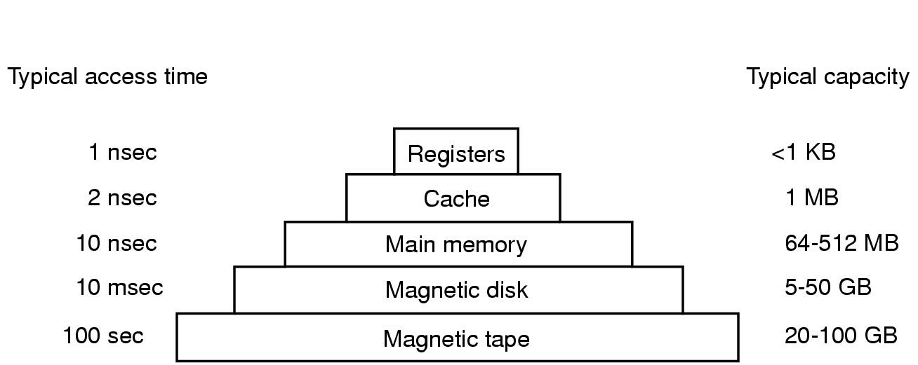
Memory Management
Memory hierarchy
small amount of fast, expensive memory – cache
some medium-speed, medium price main memory
gigabytes of slow, cheap disk storage
Memory manager handles the memory hierarchy
94

Slide 95
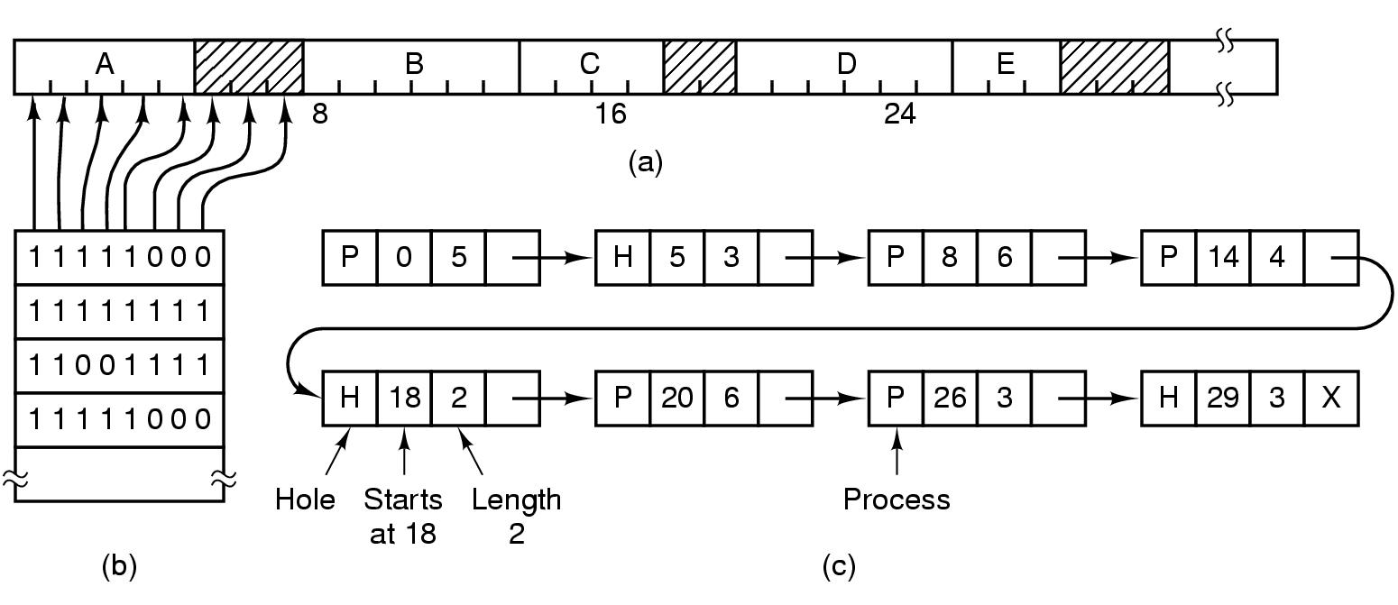
Memory Management with Bit Maps & List
Bit Maps & List method
Drawback of bitmaps: to find consecutive 0 bits in the map is time-consuming
95

Slide 96
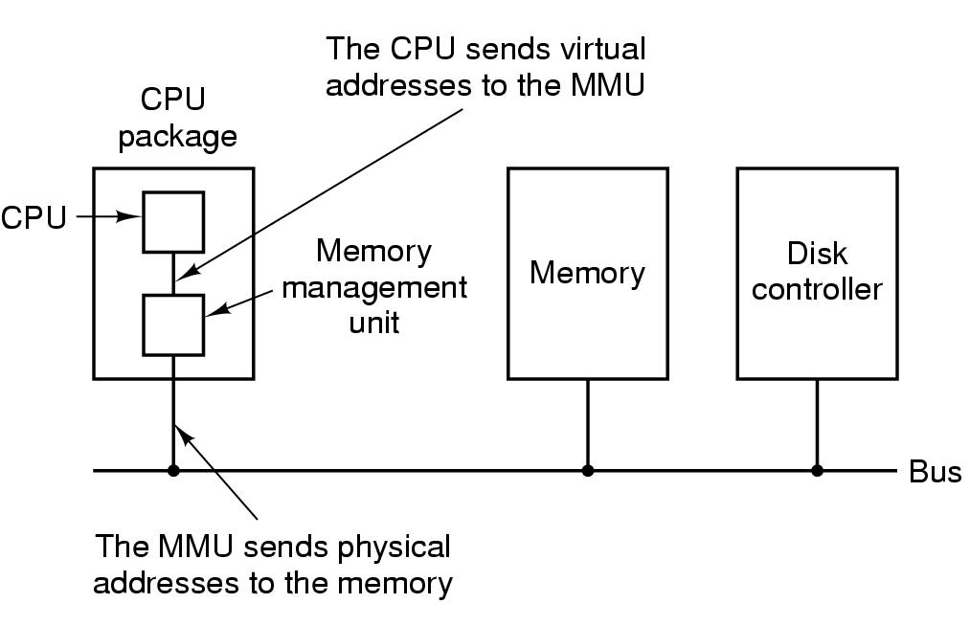
Virtual Memory
Problem: Program too large to fit in memory
Virtual memory - OS keeps the part of the program currently in use in memory
Paging is a technique used to implement virtual memory.
Virtual Address is a program generated address.
The MMU (memory management unit) translates a virtual address into a physical address.
96

Slide 97
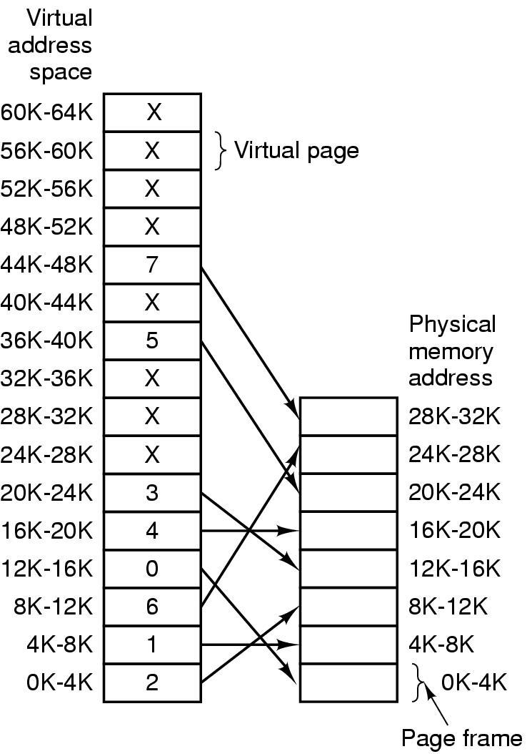
Page Table
The relation between virtual addresses and physical memory addresses given by page table
97

Slide 98
Pure paging
98

Slide 99
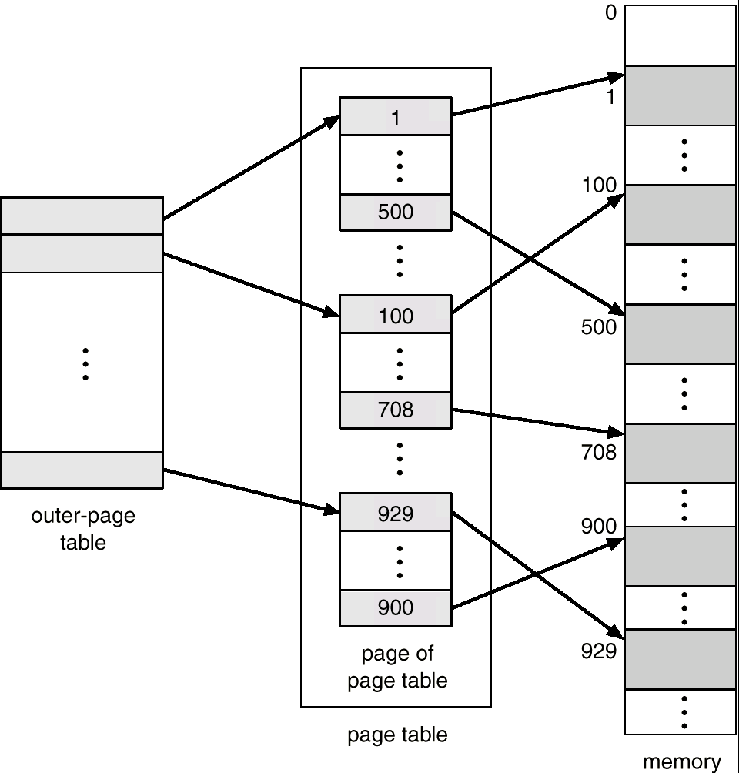
Two-Level Page-Table Scheme
99

Slide 100
TLB
Observation: Most programs make a large number of references to a small number of pages.
Solution: Equip computers with a small hardware device, called Translation Look-aside Buffer (TLB) or associative memory, to map virtual addresses to physical addresses without using the page table.
100

Slide 101
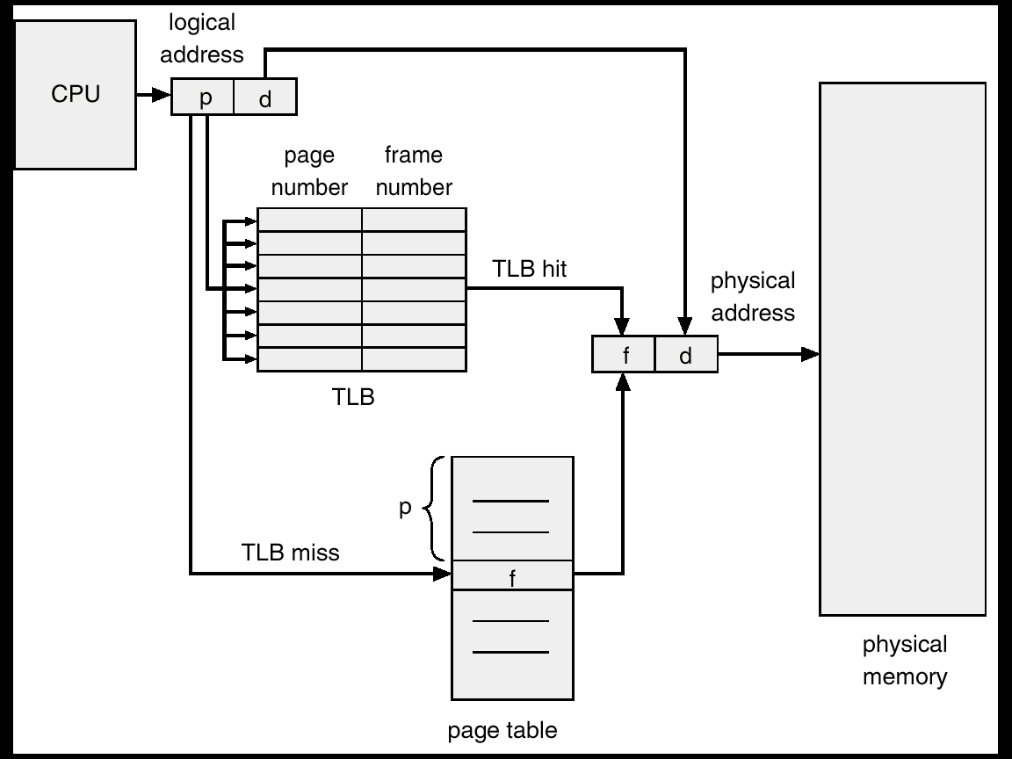
Paging Hardware With TLB
101

Slide 102
Inverted Page Table
Usually, each process has a page table associated with it. One of drawbacks of this method is that each page table may consist of millions of entries.
To solve this problem, an inverted page table can be used. There is one entry for each real page (frame) of memory.
Each entry consists of the virtual address of the page stored in that real memory location, with information about the process that owns that page.
102

Slide 103
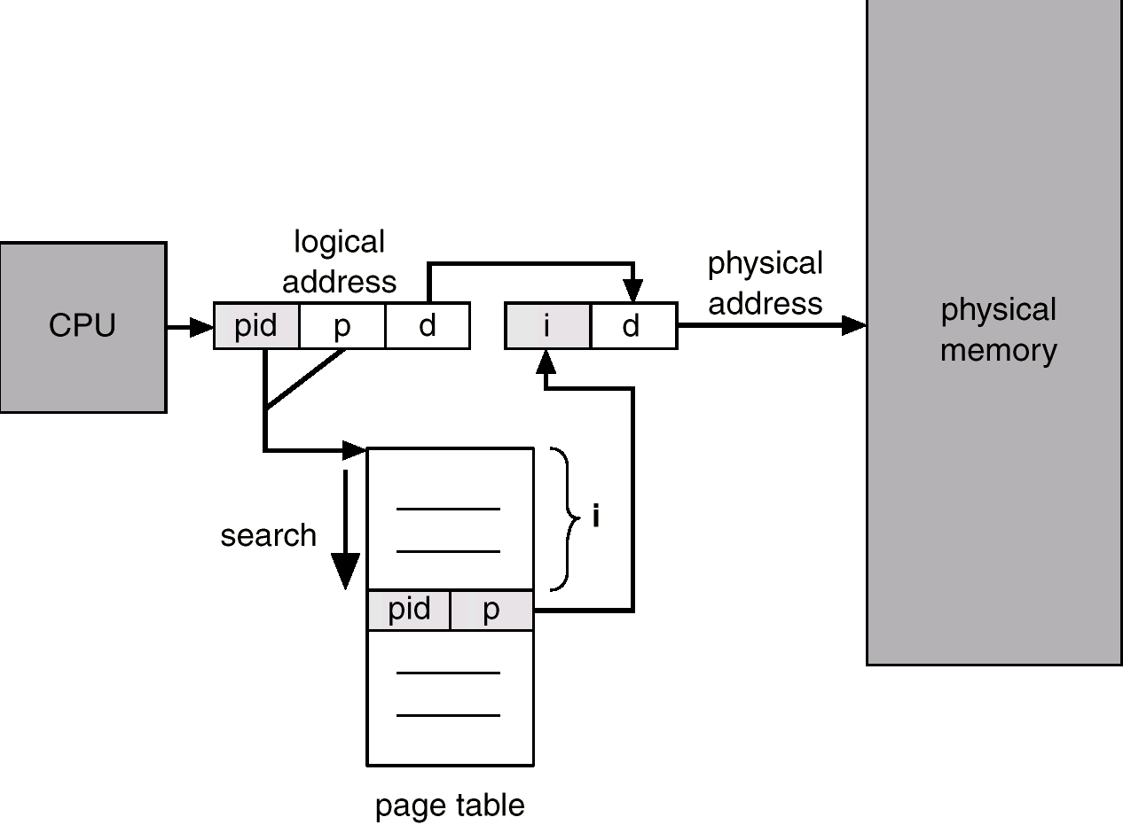
Inverted Page Table Architecture
103

Slide 104
Page Replacement Algorithms
Page fault forces choice
which page must be removed
make room for incoming page
Modified page must first be saved
unmodified just overwritten
Better not to choose an often used page
will probably need to be brought back in soon
104

Slide 105
Not Recently Used Page Replacement Algorithm
Each page has Reference bit (R) and Modified bit (M).
bits are set when page is referenced (read or written recently), modified (written to)
when a process starts, both bits R and M are set to 0 for all pages.
periodically, (on each clock interval (20msec) ), the R bit is cleared. (i.e. R=0).
Pages are classified
Class 0: not referenced, not modified
Class 1: not referenced, modified
Class 2: referenced, not modified
Class 3: referenced, modified
NRU removes page at random
from lowest numbered non-empty class
105

Slide 106
Least Recently Used (LRU)
Assume pages used recently will used again soon
throw out page that has been unused for longest time
Software Solution?
Must keep a linked list of pages: most recently used at front, least at rear; update this list every memory reference Too expensive!!
Hardware solution?
Equip hardware with a 64 bit counter.
106

Slide 107
Simulating LRU in Software
LRU hardware is not usually available. NFU (Not Frequently Used) is implemented in software.
At each clock interrupt, the R bit is added to the counter associated with each page. When a page fault occurs, the page with the lowest counter is replaced.
Difference? Problem?
NFU never forgets, so a page referenced frequency long ago may have the highest counter.
Modified NFU = NFU with Aging - at each clock interrupt:
The counters are shifted right one bit, and
The R bits are added to the leftmost bit.
In this way, we can give higher priority to recent R values.
107

Slide 108

Simulating LRU in Software
The aging algorithm simulates LRU in software
Note 6 pages for 5 clock ticks, (a) – (e)
108

Slide 109
Working-Set Model
Pages are loaded only on demand. This strategy is called demand paging.
During the phase of execution the process references relatively small fraction of its pages. This is called a locality of reference.
The set of pages that a process is using currently is called its working set.
A program causing page faults every few instructions is said to be thrashing.
Paging systems keep each process’s working set in memory before letting the process run. This approach is called the working set model.
109

Slide 110
Working-Set Model
The idea is to examine the most recent page references. Evict a page that is not in the working set.
The working set of a process is the set of pages it has referenced during the past τ seconds of virtual time (the amount of CPU time a process has actually used).
Scan the entire page table and evict the page:
R= 0, its age is greater than τ.
R = 0, its age is not greater than τ and its age is largest.
R = 1, randomly choose a page.
The basic working set algorithm is expensive. Instead, WSCLock is used in practice.
110

Slide 111

Modeling Page Replacement Algorithms
Belady’s anomaly:
More page frames might not always have fewer page faults.
111

Slide 112

Page Replacement
3 Frames
FIFO ：15 page faults
LRU ：12 page faults
112

Slide 113
Page Size
Small page size
Advantages:
less internal fragmentation
Disadvantages:
programs need many pages → larger page tables
113

Slide 114
Page Size
Overhead due to page table and internal fragmentation
s = average process size in bytes,
p = page size in bytes,
e = page entry
page table space
internal fragmentation
Optimized when
114

Slide 115
Page Fault Handling
1. Hardware traps to kernel
2. Save general registers
3. Determines which virtual page needed
4. Seeks page frame
5. If the selected frame is dirty, write it to disk
6. Brings new page in from disk
7. Page tables updated
8. Instruction backed up to when it began
9. Faulting process scheduled
10. Registers restored & Program continues
115

Slide 116

Segmentation
116

Slide 117
Segmentation with Paging (MULTICS)
CPU
Y
d < limit?
Main
memory
N
D
S
D
Segment table
error
p
d’
+
page table
limit
PT base
f
f
d’
Physical
address
117

Slide 118
File Access
Sequential access
read all bytes/records from the beginning
cannot jump around
convenient when medium was magnetic tape
Random access
bytes/records read in any order
essential for database systems
118

Slide 119
Directories
File systems have directories or folders to keep track of files.
Two different methods are used to specify file names in a directory tree:
Absolute path name consists of the path from the root directory to the file. e.g., cp /usr/ast/mailbox /usr/ast/mailbox.bak
Relative path name consists of the path from the current directory (working directory). e.g, cp ../lib/dictionary ➔ cp /usr/lib/dictionary
119

Slide 120

File System Layout
File system layout:
MBR (Master Boot Record) is used to boot the computer.
The partition table gives the starting and ending addresses of each partition.
120

Slide 121
File System Layout
Boot block: read in by the MBR program when the system is booted.
Superblock: contains the key parameters about the file system.
Free blocks information
I-nodes tells all about the file.
Root directory
Directories and files
Load OS
121

Slide 122

File Allocation
Contiguous Allocation:
store each file as contiguous block of data.
122

Slide 123
File Allocation
Contiguous Allocation
Advantages:
Simple to implement;
Read performance is excellent.
Disadvantages:
Disk fragmentation
The maximum file size must be known when file is created.
Example: CD-ROMs, DVDs
123

Slide 124

File Allocation
Linked List Allocation:
keep linked list of disk blocks
Disadvantages ?
Slow random access speed
The amount of data in a block is not a power of 2
124

Slide 125

Linked List Allocation using an index
Take table pointer word from each block and put them in an index table, FAT (File Allocation Table) in memory.
Advantages?
The entire block is available for data
Stored in memory, fast
Drawbacks?
Occupies a large amount of memory.
For 200-GB disk, the table will take up 600M or 800 M memory.
125

Slide 126

File System Implementation
I-node (index-node):
lists the attributes and disk addresses of the file's blocks.
126

Slide 127
Virtual File Systems
Definition: the Virtual File System (or the Virtual Filesystem Switch) is the software layer in the kernel that provides the filesystem interface to user space programs.
Same API for different types of file systems
Separates file-system generic operations from implementation details
Syscalls program to VFS API rather than specific FS interface

Slide 128
Disk space management
Strategies for storing an n byte file:
Allocate n consecutive bytes of disk space
If the file grows it will have to be moved on the disk, it is an expensive operation and causes external fragmentation.
Allocate a number [n/k] blocks of size k bytes each
Blocks do not need to be adjacent.
128

Slide 129
How to determine block size？
When block size increase, disk space utilization decrease
Internal fragmentation, space efficiency decrease
When block size decrease, data transfer rate decrease
Time efficiency decrease
usual size k = 512bytes, 1k (UNIX), or 2k
129

Slide 130

Keeping Track of Free Blocks
Use linked list of disk blocks:
With 1 KB block and 32-bit disk block number.
Use bit-map: Free blocks ->1, Allocated blocks -> 0
130

Slide 131
Keeping Track of Free Blocks
Use linked list of disk blocks: Each block holds as many free disk block numbers as will fit.
With 1 KB block and 32-bit disk block number ➔ 1024 * 8/32 = 256 disk block numbers ➔ 255 free blocks (and) 1 next block pointer.
Use bit map: A disk with (n) blocks requires a bitmap with (n) bits
Free blocks are represented by 1's
Allocated blocks represented by 0's
16GB disk has 2²⁴ 1-KB and requires 2²⁴ bits ➔ 2048 blocks
Using a linked list = 2²⁴/255 = 65793 blocks.
131

Slide 132
File System Backup
Backups are made to handle: recover from disaster or stupidity.
Considerations of backups
Entire or part of the file system
Incremental dumps: dump only files that have changed
Compression
Backup an active file system
Security
132

Slide 133
File System Backup
Two strategies for dumping a disk:
Physical dump: starts at block 0 to the last one.
Advantages: simple and fast
Disadvantages: backup everything
Logical dump: starts at one or more specified directories and recursively dumps all files and directories found that have changed since some given base date.
133

Slide 134
File System Consistency
Most OS have a utility program, called a file system checker, to test the consistency of a file system.
E.g., fsck in UNIX, sfc in Windows
Two types of consistency checks can be made:
(a) block consistency
(b) file consistency
134

Slide 135
I/O Device
Two common kinds of I/O devices:
Block device: stores information in fixed-size blocks.
Character device：delivers or accepts a stream of characters, without regard to any block structure.
Special device: e.g., clocks.

Slide 136


Principles of I/O Hardware
I/O devices cover a huge range in speeds

Slide 137

Device Controllers
Components of I/O devices:
Mechanical component ;
Electronic component：i.e., device controller

Slide 138
Device Controllers
A device controller is a part of a computer system that makes sense of the signals going to, and coming from the CPU.
Each device controller has a local buffer and some registers. It communicates with the CPU by interrupts. A device's controller plays as a bridge between the device and the operating system.

Slide 139

Programmed I/O
Programmed input/output (PIO)
A method of transferring data between the CPU and a peripheral.
Software running on the CPU uses instructions to perform data transfers to or from an I/O device.

Slide 140

Interrupt
Bus
How interrupts happens?
Connections between devices and interrupt controller actually use interrupt lines on the bus rather than dedicated wires

Slide 141

Direct Memory Access (DMA)
Operation of a DMA transfer

Slide 142

I/O Software Layers
Layers of the I/O Software System

Slide 143



Magnetic Disk
Hard disks and floppy disks
Organized into cylinders, tracks, and sectors.

Slide 144
Disk Formatting
A low-level format operation should be done on a disk before the disk can be used.
Each track consists of a number of sectors, with short gaps between the sectors.
512 Bytes
16 Bytes
A disk sector

Slide 145

Cylinder Skew
Cylinder skew: the position of sector 0 on each track is offset from the previous track when the low-level format is laid down.

Slide 146

Disk Interleaving
Motivation: when the copy to memory is complete (need some time cost), the controller will have to wait almost an entire rotation time for the second sector to come around again.
(a) No interleaving; (b) Single interleaving; (c) Double interleaving.

Slide 147
Disk Arm Scheduling Algorithms
Time required to read or write a disk block determined by 3 factors
Seek time
Rotational delay
Actual transfer time
Seek time dominates
Error checking is done by controllers

Slide 148

Disk Arm Scheduling Algorithms: (Shortest Seek First, SSF)
Requests：11, 1, 36, 16, 34, 9, and 12
Initial
position
Pending
requests
Shortest Seek First (SSF) disk scheduling algorithm

Slide 149

Disk Arm Scheduling Algorithms: (Elevator Algorithm)
Requests：11, 1, 36, 16, 34, 9, and 12
The elevator algorithm for scheduling disk requests

Slide 150

Clock Hardware
The crystal oscillator can generate a periodic signal in the range of several hundred MHz.
Two modes: one-shot mode, and square-wave mode.
Clock ticks: periodic interrupts caused by the programmable clock.
A programmable clock.

Slide 151

Clock Software
The functions of clock driver
Maintaining the time of day.
Preventing processes from running too long.
Handling the alarm system calls (e.g., ACK).
Others.
Three ways to maintain the time of day.

Slide 152
Power Management (1)
Device | Li et al. (1994) | Lorch and Smith (1998)
Display | 68% | 39%
CPU | 12% | 18%
Hard disk | 20% | 12%
Modem |  | 6%
Sound |  | 2%
Memory | 0.5% | 1%
Other |  | 22%
Power consumption of various parts of a notebook computer.
The most common method to save battery is to design the devices to have multiple states:
On, Sleep, and Off.

Slide 153

Power Management (2)
Running at full clock speed.
Cutting voltage by two cuts clock speed by two and power consumption by four.

Slide 154
Power Management (3)
The user can run longer on a given battery by accepting some quality degradation.
Abandon the color information and display the video in black and white.
Use radio link to send task to other devices.
Trading image quality to reduce the transmission overload.

Slide 155

Basic of Cryptography
Encoding：C=E(P,K_{E})
Decoding：P = D(C, K_{D})
Kerckhoffs’s Principle：The algorithm should all be public and the secrecy should reside exclusively in the keys.
Relationship between the plaintext and the ciphertext.

Slide 156
Secret-Key Cryptography
Monoalphabetic substitution: replace every character by a new one using a key table.
e.g., ATTACK → QZZQEA
Secret-Key Cryptography is also called as symmetric-key cryptography, for it is easy to find the decryption key given the encryption key, and vice versa.
The secret-key cryptography is relatively secure if the keys are long enough.

Slide 157
Public-Key Cryptography
All users use a pair of encryption key and decryption key. The encryption key can be made public and the private decryption key is kept secret.
Given a well-chosen encryption key, it is impossible to discover the corresponding decryption key.
Step 1：Sender uses encryption key to encode the doc；
Step 2：Receiver uses decryption key to decode the doc.
Drawback：requires a lot of computation cost.

Slide 158

Digital Signatures
(b)
Step 1）Sender publics the encryption key and uses the decryption key to encode the hash value D；
Step 2）Receiver use the encryption key decode D and compare it with the calculated hash value. If the value are consistent, then accept.

Slide 159
Malicious code （Malware）
Definition of traditional computer viruses: a set of computer instructions or programs that can destroy computer functions or data and self-replicating, which are programmed as or inserted into programs.
The official definition of computer viruses doesn’t cover the new malicious codes.
Definition of malicious codes: Software or codes aimed at destroying hardware or software, stealing user information or disturbing users without authorization.

Slide 160
Classification of malicious code
Traditional computer viruses
Infect the operating system bootloader
Infect executable files
Infect data file
Other malicious code
Trojan Horses, worms, rogue software, backdoor, mobile malicious code…

Slide 161
Virus
Virus: a special program that can reproduce itself by attaching its code to another program. Once executed, the virus can do whatever damages onto the victim’s computer.
Virus = a program which can reproduce itself
Attaching to another program
Do damages
The purpose of virus writers
Fast to spread
Difficult to detect
Difficult to delete

Slide 162
Worms
Worm: A kind of malwares that exploit system vulnerabilities for self-reproduction. Without attaching to other programs, it can be executed independently.
Worms can cause network congestion.
A worm consist of two programs:
The bootstrap
The worm proper
A worm hides its existence firstly, and then it attempts to spread its bootstrap to other machines connected to the host computer.

Slide 163
Trojan Horses
Control a victim’s computer via a specific program called the Trojan horse program.
No self-reproduction; No voluntary infection
Break into a victim’s computer by hidden in software or a Web page that people voluntarily download.
The mal can steal the victim’s files, remotely control the victim’s computer once the downloaded Trojan horse program gets executed

